Slide 1
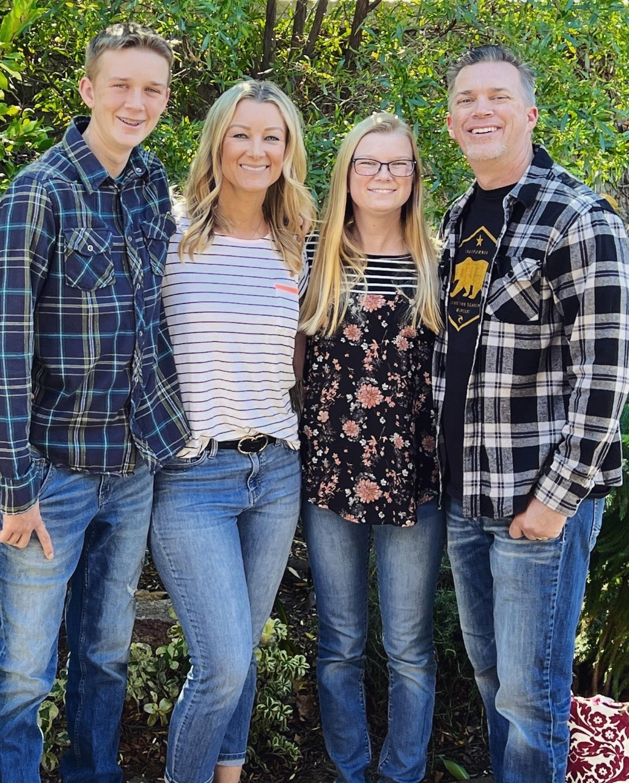
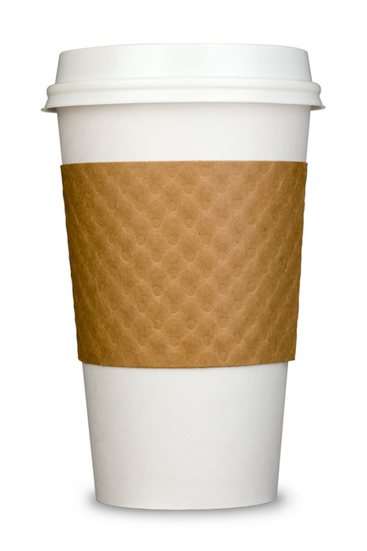
Mrs. Cunningham
Insert photo
here
Hello! I’m Jennifer Cunningham and I am so excited to be your 3rd Grade teacher! It’s going to be a year full of fun, learning, and tremendous growth. 3rd Grade is the best! This is my 24th year teaching in Chino. I have my Bachelor’s degree and Multiple Subject Credential from Cal State San Bernardino.
I grew up in Chino and now live in Eastvale with my husband and two children, Kayla (19) & Cole (16). Kayla is studying aerospace engineering at UC Davis and Cole is starting his junior year in high school.
Jennifer_Cunningham@chino.k12.ca.us
Remind code:
@mrsc234
teaching! ☺ coffee
family iced tea
friends pink & teal
my dog caramel
camping Chick fil A
the beach Amazon
country music Target

